Slide 1
The ENVIRONMENTS FOR FOSTERING EFFECTIVE CRITICAL THINKING (EFFECTs)
Inquiring Pedagogies 2012
4th Annual Fall Teaching Conference
Charles Pierce, University of South Carolina
Isaac Wait, Marshall University
Tuesday, August 21st, 2012

Slide 2
Workshop Objectives
Share recent experiences with Environments for Fostering Effective Critical Thinking (EFFECTs) at Marshall University
Explain the framework of EFFECTs
Share tools that facilitate the development, deployment, and assessment of EFFECTs
Invite you to develop and deploy EFFECTs in your courses …

Slide 3
Why I’m pro-EFFECTs
Has provided a teaching “Paradigm” that is fundamentally sound and infinitely adaptable.
Helps me to teach more creatively.
Forces me to plan more deliberately, and thoughtfully design learning experiences.
Students are more engaged in the course and the material.

Slide 4
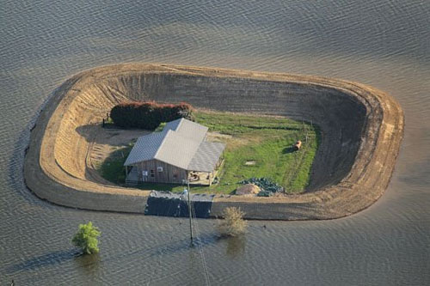
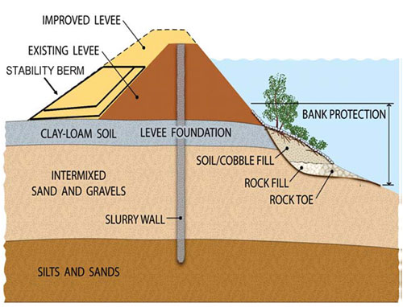
EFFECTs at Marshall
Geotechnical Engineering – What pumping flow rate of water is needed to protect this home from flooding?
What follow-up questions should a student ask when given this driving question?

Slide 5
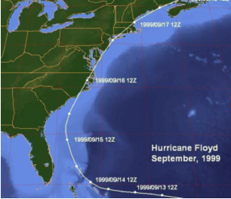
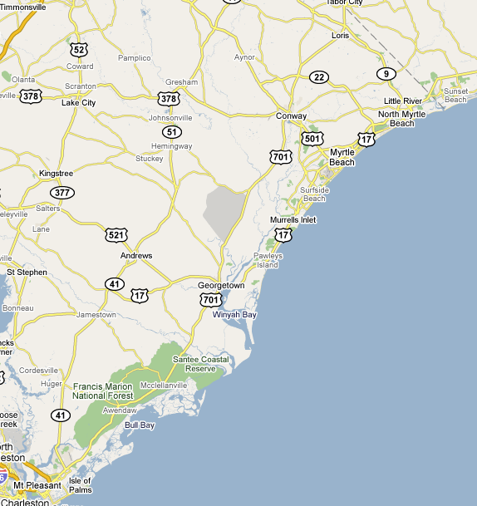
Other EFFECTs at Marshall
Transportation Engineering - How much time will it take to get all evacuees out of the Myrtle Beach area under a mandatory evacuation?

Slide 6
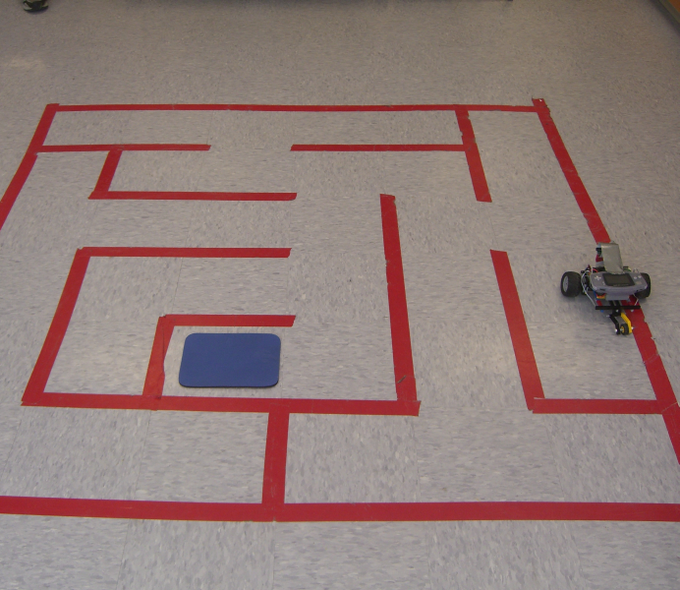

Other EFFECTs at Marshall
Computer Science – How do you develop an algorithm that can find a maze path from start to exit?

Slide 7
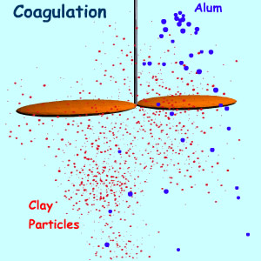
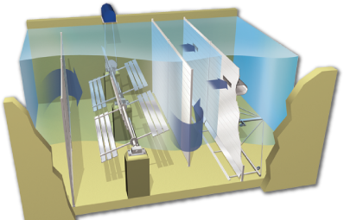
Other EFFECTs at Marshall
Water Treatment – How many pounds of aluminum sulfate per day would be needed for coagulation of 20 million gallons per day of river water to produce a potable effluent?

Slide 8


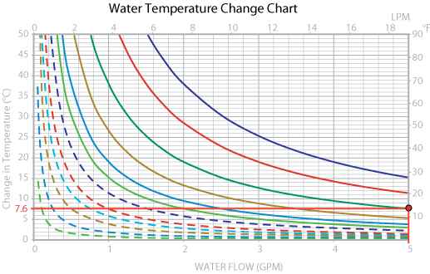
Other EFFECTs at Marshall
Thermodynamics – How much electricity can be saved in a year by allowing hot soup to cool on the counter before placing it into a refrigerator?

Slide 9
EFFECTs in First Year Seminar
Driving question: What is good music?
Activities:
Listen to songs, write a brief critical response.
Identify characteristics of “good” vs. “bad” songs.
Attempt to match music critic quotes to corresponding songs.
Partner discussion and ranking of the most important characteristics for evaluating music.
Rewrite other students’ critical responses.

Slide 10
FYS “Driving Questions”
What is good music?
What is great about America?
What is good nutrition?
Why are you in college?
What is racism?
How do you learn?
What is critical thinking?
How do you win friends and influence people?
Is nuclear power viable?
What are your financial goals?
Are guns bad?
How can you become a millionaire?
What is sport?
What is funny?
What are the reasons that some people believe in God?

Slide 11
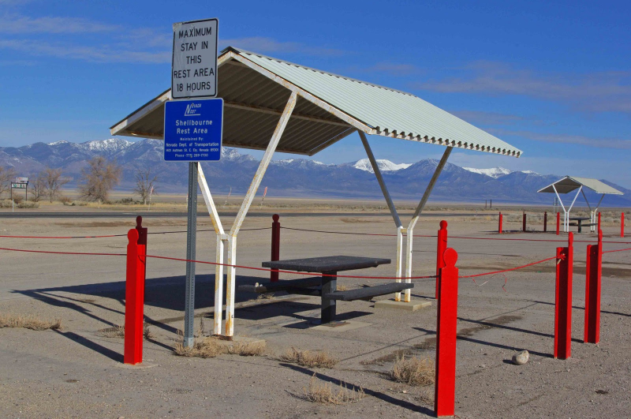


Solar Power EFFECT
Context: A highway rest-stop in Nevada is being upgraded. Because of its remote location, electricity is not available from ‘the grid’, and solar power is being explored as an alternative.
Driving Question: How much will it cost to install a solar power system at the renovated rest stop?

Slide 12


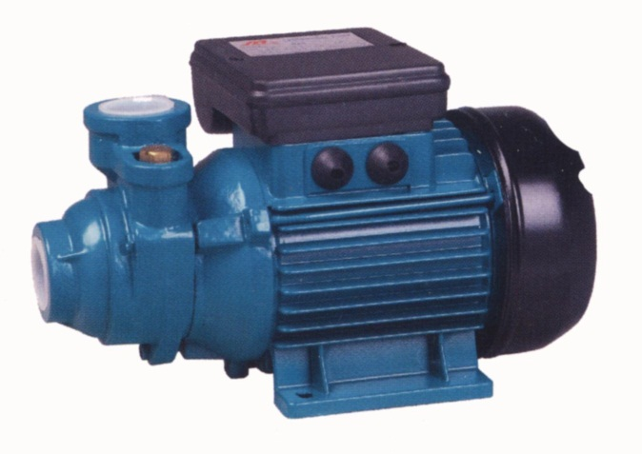
Active Learning Module 1 – Demand Estimation
Measure the peak & running load of various devices
Introduce students to ‘Demand Estimation’ phase of design

Slide 13

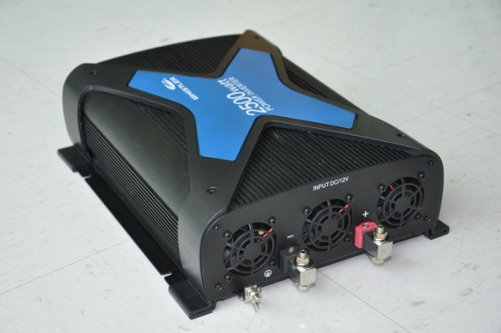
Active Learning Module 2 – Inverter Efficiency Characterization
Power In vs. Power Out
Introduce concept of ‘efficiency’
Need for revision & iteration
Update estimates of power demand to reflect efficiency factors

Slide 14
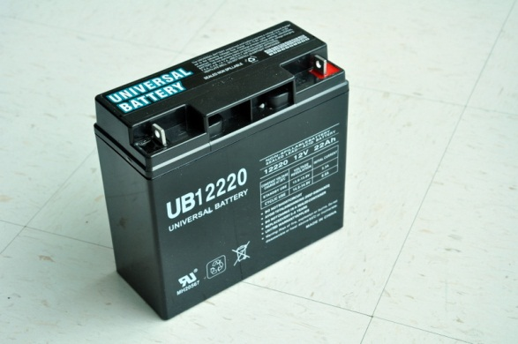
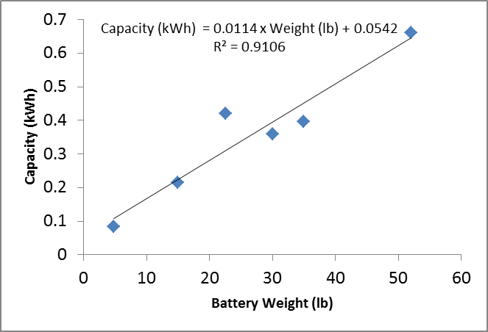
Active Learning Module 3 – Battery Weight, Capacity, and Modeling
Models
Physical: battery powered hair dryer run time
Numerical: battery weight vs. capacity

Slide 15
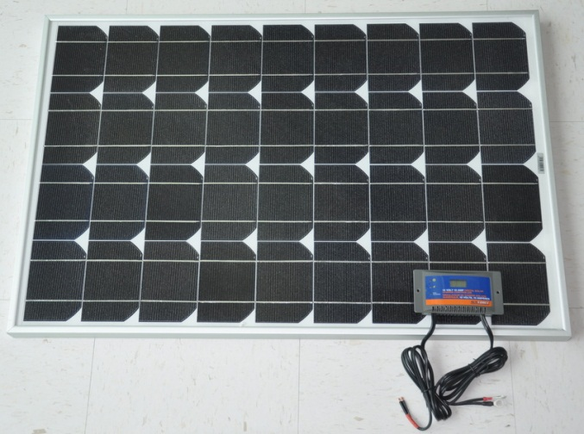
Active Learning Module 4 – Solar Panel Characterization
Measured output vs. quoted
Temporal distribution of parameters
Safety factors & probability

Slide 16
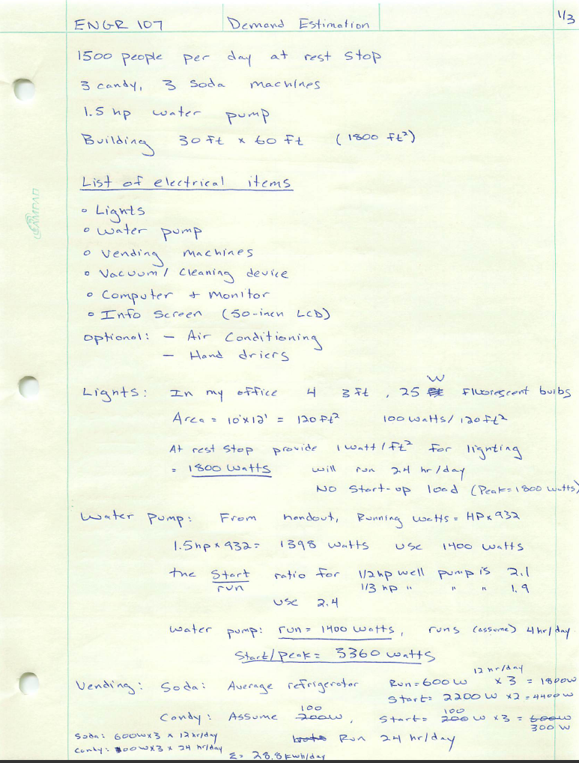
Final Design
Neatness & logic in technical communication
Enforcement of follow-through requirement
Final ‘updated’ answer to original driving question

Slide 17
The ENVIRONMENTS FOR FOSTERING EFFECTIVE CRITICAL THINKING (EFFECTs)
EFFECTs Functional Framework

Slide 18
Critical Thinking
What is critical thinking?

Slide 19
Think-Pair-Share
What is critical thinking?
What types of activities and assignments are best in stimulating critical thinking skills in the classes that you teach?
Describe a time from your own education when critical thinking was engaged and strengthened.
What problems arise in your discipline when someone lacks critical thinking skills?
How can critical thinking be measured?

Slide 20
Critical Thinking
“skillful, responsible thinking that facilitates good [engineering] judgment because it relies upon criteria, is self correcting, and is sensitive to content” (Lipman 1988)
EFFECTs …
provide discipline-specific context
provide criteria [e.g. design problem]
provide opportunities for self-exploration and self-correction [through active learning and reflection]
are modular and flexible to be applied at different academic levels and settings [e.g. intro vs. advanced class]

Slide 21
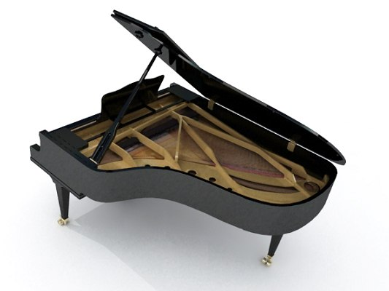
Estimation
How many piano tuners are there in Chicago?

Slide 22
Estimation
How many piano tuners are there in Chicago?
1.
2.
3.
4.
5.
6.
7.
8.
9.

Slide 23
Estimation
How many piano tuners are there in Chicago?
Santos (2009)
estimated 120
43 in phone book

Slide 24
The ENVIRONMENTS FOR FOSTERING EFFECTIVE CRITICAL THINKING (EFFECTs)
EFFECTs Functional Framework

Slide 25
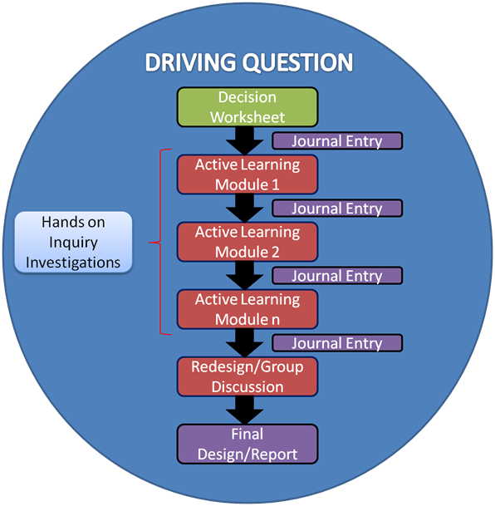
EFFECTs Functional Framework
Driving Question
Decision Worksheet
initial answer to DQ
Active Learning Modules
Journal Entries
Report
final answer to DQ

Slide 26
Driving Question: Class 1
All components revolve around and relate to driving question
Think of this as “setting the stage” for students

Slide 27
Driving Question: Examples
How many tons of soil are needed to rebuild a 100-ft long levee in New Orleans?
What is the least expensive structure to support a water tower subject to earthquakes?
How much time will it take to get all hurricane evacuees out of Myrtle Beach under a mandatory evacuation?

Slide 28
Decision Worksheet: Class 1
Decision worksheet prompts students for initial answer to driving question
Complete individual worksheet and then group worksheet

Slide 29
Decision Worksheet
“I think the best part … was every two weeks we got a piece of paper and it had a situation. And they asked us to just estimate anything, really, in our heads … what would happen if different situations happened ... We just had to put whatever our estimation was, or write out all these factors on each page.”

Slide 30
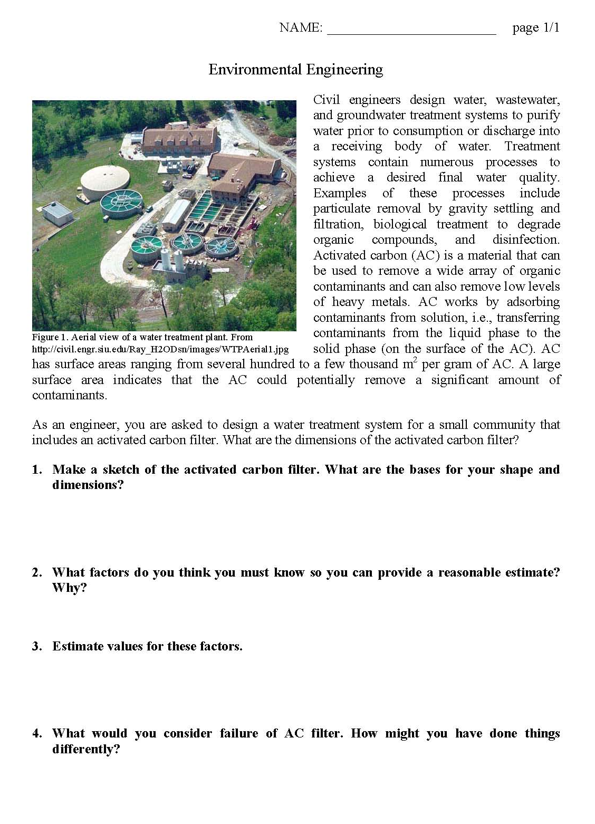
Decision Worksheet: Components
Background

Slide 31
Decision Worksheet: Components
Background
Driving Question

Slide 32
Decision Worksheet: Components
Background
Driving Question
Guiding Questions

Slide 33
Guiding Questions: Example
Sketch the levee.
What factors are needed to estimate weight of soil for levee?
Estimate values for these factors.
What constitutes failure of levee?

Slide 34
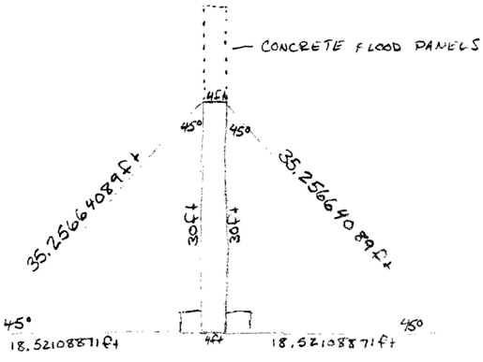
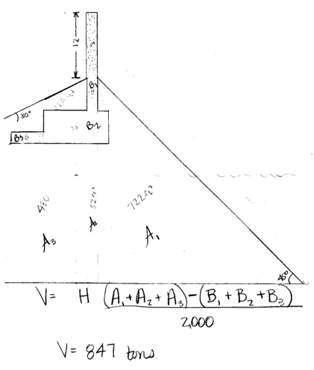
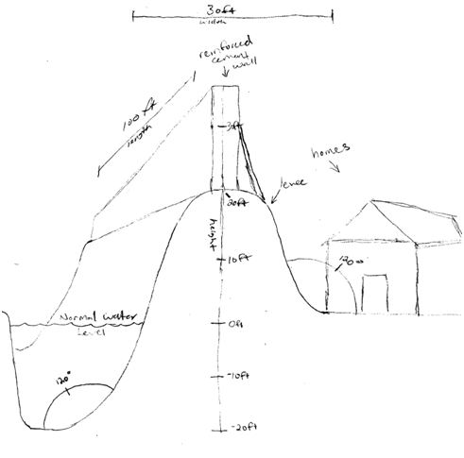
Levee Sketches

Slide 35
Active Learning: Classes 2 … n
Active learning modules facilitate self-exploration of concepts needed to answer driving question
Complete exercises in groups

Slide 36
“I think the best part … was every two weeks we got a piece of paper and it had a situation. … Then as the week progressed, you basically made that situation come to life with the hands-on activities.”

Slide 37
Active Learning Modules: Examples
EFFECT | Session 1 | Session 2 | Session 3 | Session 4
Geotechnical | Decision Worksheets | Density of Solids | Compaction and Soil Density | Construction and Testing of Model Levee
Environmental |  | Calibration Curves and Measuring Concentrations with a Spectrophotometer | Material Balances and Adsorptive Capacity of Activated Carbon | N.A.
Water Resources |  | Pressure Variation with Height | Pressure Variation with Flow | N.A.
Structural |  | Moment of Inertia of Structural Sections | Natural Frequencies and Resonance | Construction and Testing of Model Tower
Transportation |  | Evacuation Planning | Flow Rate | Computer Simulation of Traffic Flow
Surveying |  | Accuracy and Precision of Area Estimations | Measurement Accuracy of Different Tools | N.A.

Slide 38
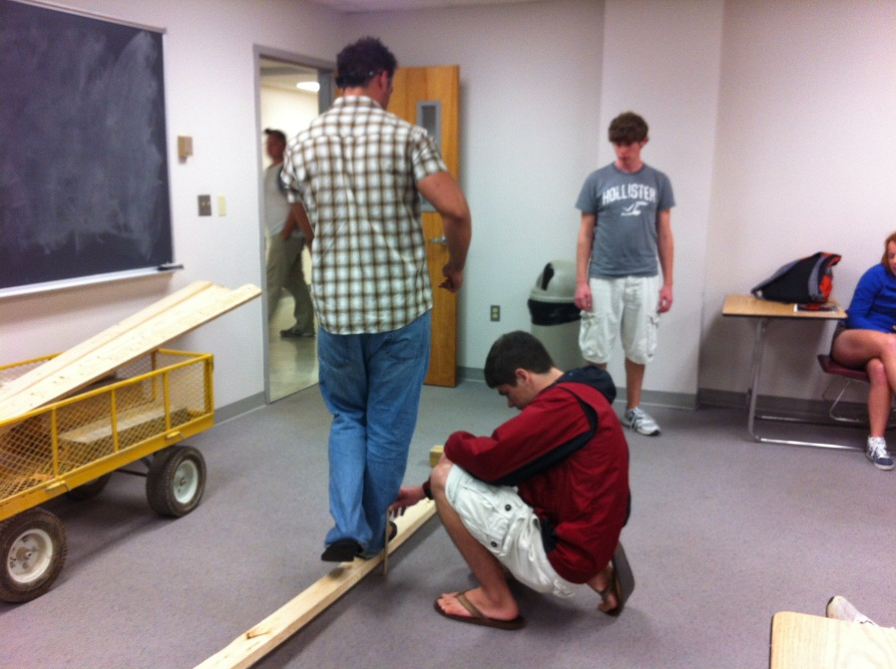
Structural: Beam Deflection

Slide 39
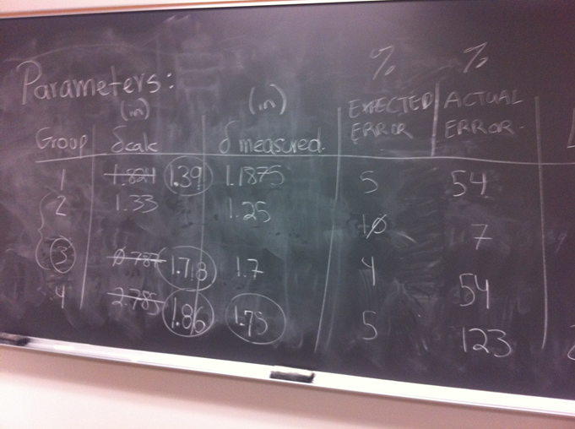
Structural: Beam Deflection

Slide 40
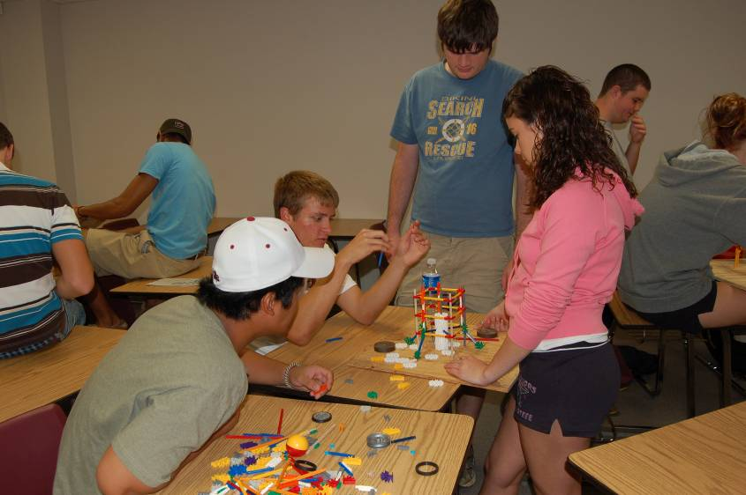
Structural: Model Towers

Slide 41
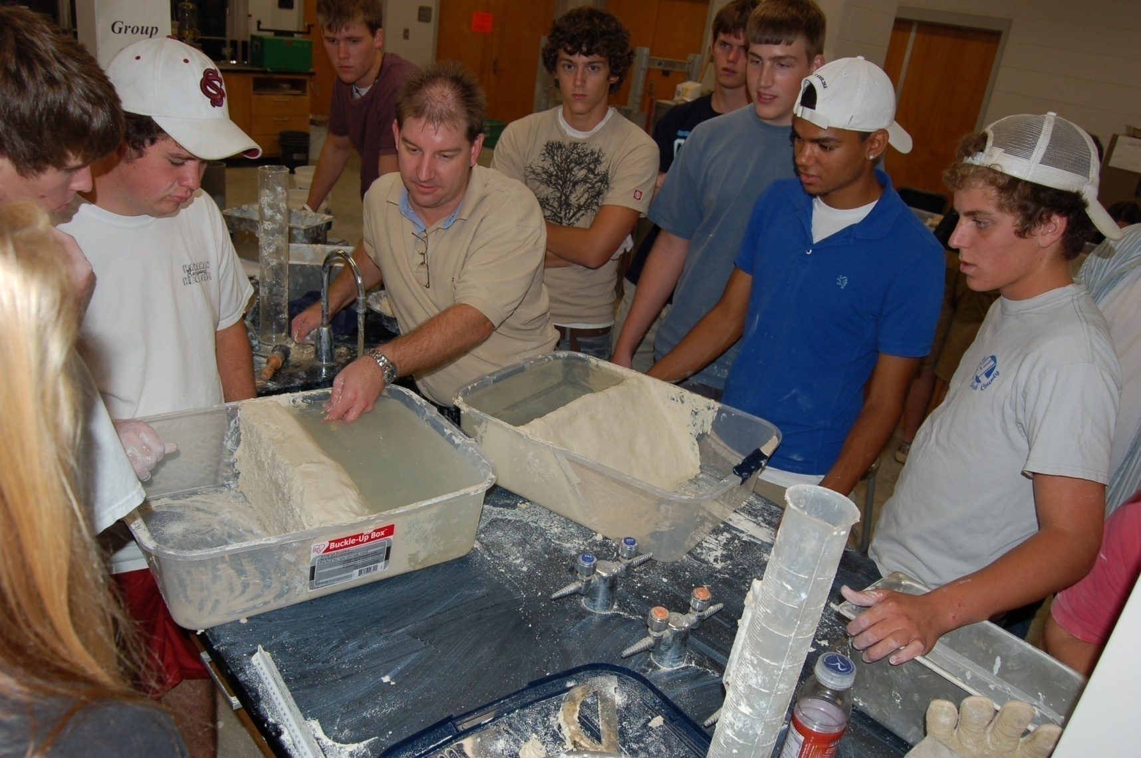
Geotechnical: Model Levees

Slide 42
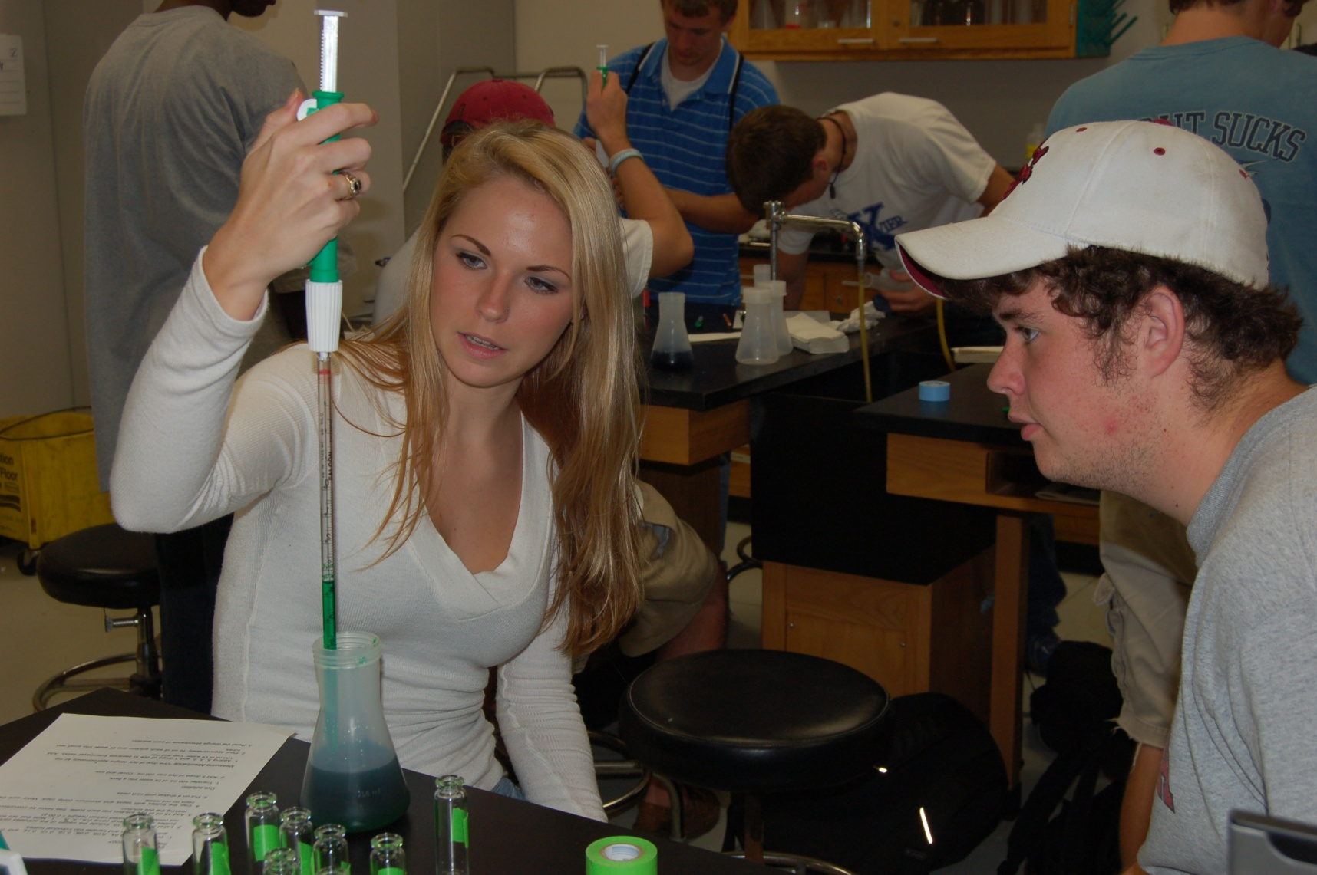
Environmental: Calibration Curves

Slide 43
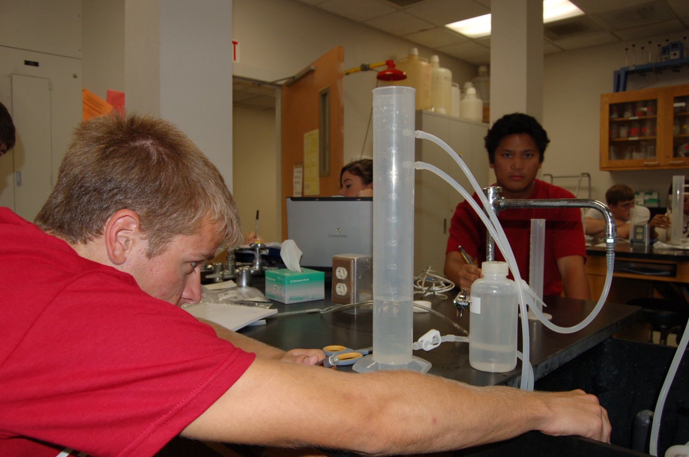
Water Resources: Pressure-Height

Slide 44
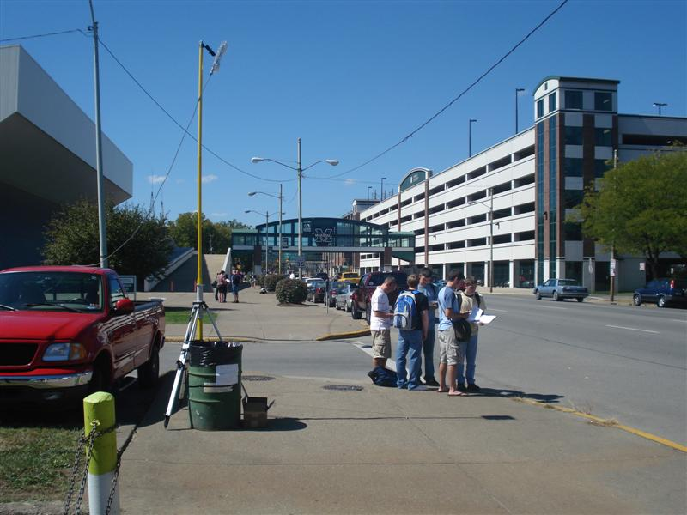
Transportation: Flow Rate

Slide 45
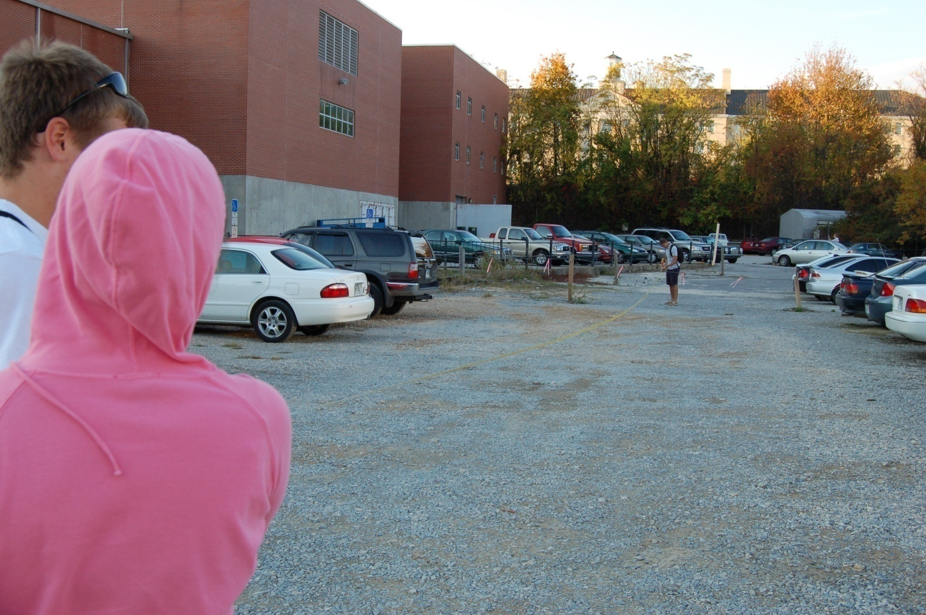
Surveying: Measurement Accuracy

Slide 46
Journal Entries: Classes 2 … n
Journal questions facilitate reflection on active learning modules
Complete individual responses after class

Slide 47
Journal Entries: Components
What was learned in class today?
Why is that new knowledge important for answering the driving question?
How has your initial answer to the driving question changed?

Slide 48
Final Report: Post Class n
Final report prompts students for final answer to driving question
Complete individual reports

Slide 49
Final Report: Components
Introduction
why is driving question important?
Solution
show solution steps with supporting explanation and justification
Lessons Learned
reflect on learning process
discuss how final answer changed from initial answer

Slide 50
Integration, Not Addition
EFFECTs are pedagogical approach to packaging and delivering the same course material
Think big, but start small
implement pieces of EFFECTs first (e.g. decision worksheet, active learning exercises, journal entries)
add more pieces in future course offerings, eventually to create a complete EFFECT

Slide 51
The ENVIRONMENTS FOR FOSTERING EFFECTIVE CRITICAL THINKING (EFFECTs)
EFFECTs Developmental Framework

Slide 52
Developmental Framework
Driving Question
Decision Worksheet
Guiding Questions
Concepts x, y, z
Active Learning Modules x, y, z

Slide 53
Concepts
Think about and identify concept(s) that are
challenging for students to understand
conducive to active learning
can be connected under the “umbrella” of a broad question

Slide 54
Active Learning
“The single most important reason for developing and using active learning approaches in your classes is to promote critical thinking. (You can’t teach someone how to think by lecturing to them about how you think.)”
During active learning, students are involved in higher order thinking (analysis, synthesis, and evaluation), whether or not the body (or the mouth) is physically active.
from the workshop on “Teaching and Evaluating Critical Thinking” by E. Neal

Slide 55
Active Learning: Self-Correction
“They let you make your own mistakes to begin with …”
“… they didn’t penalize you if you did something crazy that was wrong. They wanted to encourage you to try crazy ideas …”

Slide 56

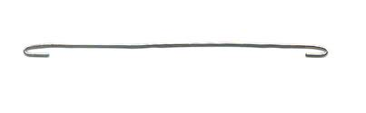



Active Learning: Be Resourceful

Slide 57
Active Learning: Strategies
Interactive Lecturing with Student Learning Groups
web site and video by Richard Felder
Think-Pair-Share Students think about a question individually and then pair up to discuss the answer. Student pairs share their answers with the whole class.
Guided Reciprocal Peer Questioning Students work in groups to prepare questions about the discussion topic.
Cooperative Note-Taking Pairs Students work together in taking notes. Breaks are given during class for one student to summarize notes while the other asks questions about the notes.
from the workshops on “Active and Cooperative Learning” by R.M. Felder and R. Brent
“Teaching and Evaluating Critical Thinking” by E. Neal

Slide 58
Active Learning: EFFECTs
Decision Worksheets [individuals/groups]
Hands-On Activities [groups]
e.g. students design their own experiments (environmental: filter) or construct and test their own models (geotechnical: levee) with given resources
Active Learning Worksheets [individuals/groups]
Reflective Writing [individuals]
e.g. journals, confidence questions, lessons learned
Report Writing [individuals]
Lessons Learned: How has your preliminary design changed from the first day [when you completed the decision worksheet]? What things did you learn that affected these changes? Discuss.

Slide 59
Driving Question
Elements of “Good” Driving Questions
represent a realistic scenario or design
set in a context that students can understand and recognize
ideally, broad enough such that the expected answer or solution can be simplified (e.g. introductory course) or complex (e.g. advanced course)

Slide 60
Driving Question: Example
How many tons of soil are needed to rebuild a 100-ft long levee in New Orleans?
Real scenario with a real problem
Students can relate to and understand the problem
Developed for freshmen in Introduction to Civil Engineering
Simplified solution based on fundamental concepts of soil classification, soil density, and compaction
Broad enough for juniors in Introduction to Geotechnical Engineering
More complex solution based on additional concepts of permeability, flow nets, hydraulic gradient/erosion/piping, effective stress, settlement, shear strength

Slide 61
Decision Worksheet
Decision worksheet provides …
context: piece of paper and it had a situation … in terms of civil engineering
criteria: put whatever our estimation was
for a given design problem
guidance: write out all these factors
that supports reaching a solution to the driving question

Slide 62
Decision Worksheet: Components
Background
Driving Question
Guiding Questions

Slide 63
“I think the best part … was every two weeks we got a piece of paper and it had a situation. … You see how your estimates were, at the end. I thought it was cool to see what your theories are, in real life, instead of just on paper and numbers and variables.”

Slide 64
Final Answers: Closing The Loop
Students need closure to the driving question
Ask students to provide a final solution to the original driving question
or a slightly modified version of the driving question
but not a new driving question
Ask them to compare the original estimate [from the decision worksheet] to the final solution

Slide 65
Final Answers: Closing The Loop
Project (Design) Reports
Decision Worksheet
can use original worksheet or a slightly modified version
provides pre-post results
Exam/Quiz Problems
can also add Confidence Questions

Slide 66
Confidence Questions
Ask students to describe their degree of confidence in the solution to a particular problem or answer to a particular question
“How confident are you in the solution to this problem? Why?”
Use this approach in project reports or exams

Slide 67
The ENVIRONMENTS FOR FOSTERING EFFECTIVE CRITICAL THINKING (EFFECTs)
EFFECTs Evaluation

Slide 68
Developmental Framework
Driving Question
Decision Worksheet
Guiding Questions
Concepts x, y, z
Journal Entries
Active Learning Modules x, y, z

Slide 69
Journal Questions
Ask students to respond to a single or set of particular question(s) about concepts that relate to the driving question
Responses can be used to measure
Core knowledge … by examining the use and understanding of appropriate, discipline-specific terms or phrases associated with those concepts
Critical thinking … by analyzing how well the student reflects on active learning and connects observations to conclusions

Slide 70
Journal Question: Example
Journal Question:
What have you learned about engaging students, and why would you want to use active learning strategies in class?
Response:
Students can be engaged without having to move around. There are a number of methods that can engage students in higher order thinking. For example, I would want to use active learning strategies such as think-pair-share in class because they allow me to engage students in a more effective way. Giving students the opportunity to interact with each other is essential for students to start developing critical thinking skills.

Slide 71
Journal Question: Example
Journal Question:
What have you learned about engaging students, and why would you want to use active learning strategies in class?
Response:
Students can be engaged without having to move around. There are a number of methods that can engage students in higher order thinking. For example, I would want to use active learning strategies such as think-pair-share in class because they allow me to engage students in a more effective way. Giving students the opportunity to interact with each other is essential for students to start developing critical thinking skills.
Core Knowledge

Slide 72
Journal Question: Example
Journal Question:
What have you learned about engaging students, and why would you want to use active learning strategies in class?
Response:
Students can be engaged without having to move around. There are a number of methods that can engage students in higher order thinking. For example, I would want to use active learning strategies such as think-pair-share in class because they allow me to engage students in a more effective way. Giving students the opportunity to interact with each other is essential for students to start developing critical thinking skills.
Observation
Critical Thinking
Conclusion

Slide 73
Journal Questions
What makes a good question?
Avoid asking only “what” questions. These questions might solicit core knowledge but do not necessarily stimulate critical thinking.
Ask “why” questions, either as independent questions or following “what” questions. Another approach is to ask a “how” question followed by a “why” question.
Make questions short and concise.
Don’t be afraid to ask for specific concepts.

Slide 74
Journal Questions
Bad example …
What did you do last class?
Would you change your original design based on what was learned in class?
Good example …
What is density?
Why is density important in civil engineering?
What did you learn in class today, and why is that important in the design of a levee? … or ….
How has your original design changed, based on what was learned in class today?

Slide 75
Journal Questions
In-class or end-of-class assignments
[paper-based]
Homework assignments
[paper-based or submission via Blackboard, for example]
Journal or notebook
[paper-based]
Online Assessment Tool (OAT)
Complete after in-class active learning exercise(s) and before next class period.

Slide 76
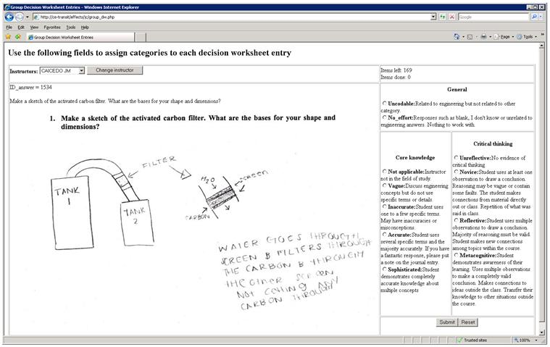
OAT Coding Module v 1.0

Slide 77
Assessment Rubric
Core Knowledge
Vague
Inaccurate
Critical Thinking
Unreflective
Novice
Accurate
Reflective
Metacognitive
Sophisticated

Slide 78
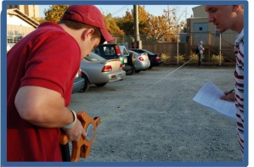
Surveying: Journal Question
Journal Question:
What have you learned about estimating areas of larger, irregular shapes?
How did that knowledge alter your answer to the driving question? How might it influence your choice of procedure for measuring the area?
Journal Response: Example 1
“Its very complicated because you have to divide everything into little sections.”

Slide 79
Surveying: Journal Question
Journal Response: Example 2
“After trying to estimate the area of the engineering parking lot, I found out that it is very difficult to come to an answer that is close to the actual one. The irregular shape of the area was accounted for by dividing it up into geometric shapes that the area could be easily found for. It was useful to use a reference point as a means of estimating, as we used the cars in the parking lot to measure the overall length. This worked fairly well, as my estimation was not as far off as I had expected.
In determining how much concrete we will need, the method of dividing up the shape into smaller ones should be very effective, as nearly all of the parking lot is covered by a few geometric shapes. I also found that the lot was not perfectly flat, which means we would have to account for the irregularities in the surface before coming to a perfectly accurate measurement of the area. My procedure for measuring the area would remain the same as what we performed on Thursday, using the tape measure to calculate the area of the shapes. Although, a longer tape measure would have eliminated the chance for error when we had to mark a spot and bring the tape measure over to continue the measurement.”

Slide 80
The ENVIRONMENTS FOR FOSTERING EFFECTIVE CRITICAL THINKING (EFFECTs)
Discussion

Slide 81
Reflection in Assignments
Reflective Homework Problems
Embed questions into the homework assignment
Add new part(s) to a homework problem that is specific to the driving question
Ask students how a particular homework problem helps them answer the driving question
Assign a final question that asks students how the entire homework assignment helps them answer the driving question
Require a revised answer to the driving question with explanation for how and why it has changed

